Slide 1
UNet Architecture
Dr Milan Joshi

Slide 2
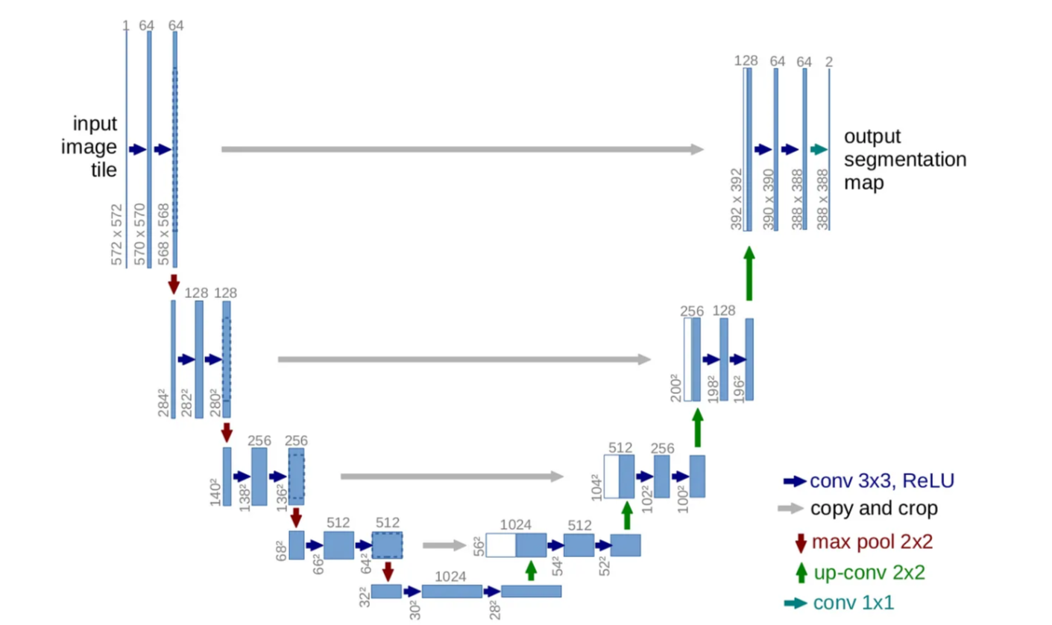

Slide 3
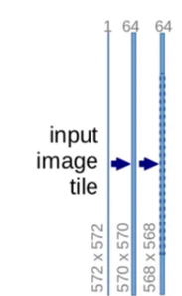

Contracting Path
Initial Image: Start with a 572x572 input image.
First Convolution: Apply 64 filters of size 3x3, with a stride of 1 and valid padding, resulting in an output size of 570x570 (since there is no padding, the image size reduces by 2 pixels for each side).
Second Convolution: Apply another set of 64 filters of size 3x3, again reducing the output size to 568x568.

Slide 4


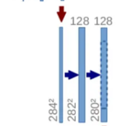
First Max Pooling: Perform a 2x2 max pooling with a stride of 2, halving the output dimensions to 284x284, and doubling the feature channels for the next convolutions.
Second Convolutional Set: Apply 128 filters of size 3x3, reducing the size to 282x282, followed by another set of 128 filters of the same size, resulting in a 280x280 output.

Slide 5
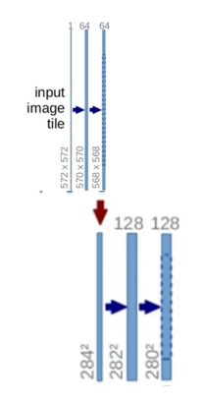

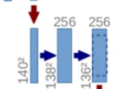
Second Max Pooling: Another 2x2 max pooling with a stride of 2 reduces the dimension to 140x140.
Third Convolutional Set: Apply 256 filters of size 3x3 twice, with outputs of 138x138 and then 136x136.

Slide 6
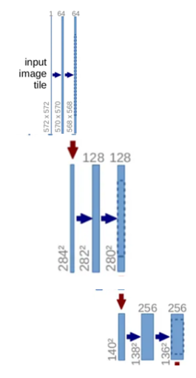


Third Max Pooling: Max pooling again to get an output of 68x68.
Fourth Convolutional Set: Apply 512 filters of size 3x3 twice, with outputs of 66x66 and then 64x64.
Fourth Max Pooling: Perform max pooling to reduce the output to 32x32.

Slide 7
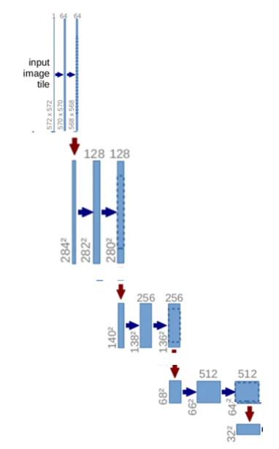

Bottleneck
This part does not include pooling. Apply 1024 filters of size 3x3 twice, with outputs of 30x30 and then 28x28.

Slide 8
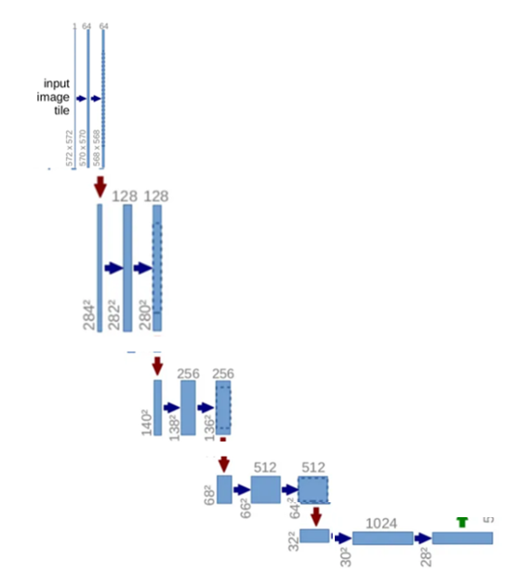
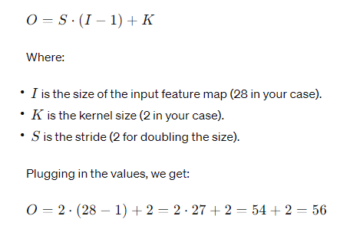

First Up-convolution: Apply a 2x2 up-convolution (transpose convolution) that halves the number of feature channels (from 1024 to 512) and increases the size to 56x56.
First Concatenation: Concatenate the up-convolved features with the correspondingly cropped feature map from the contracting path (from step 9), which has been cropped to the size of 56x56 to match.

Slide 9
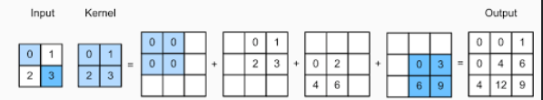
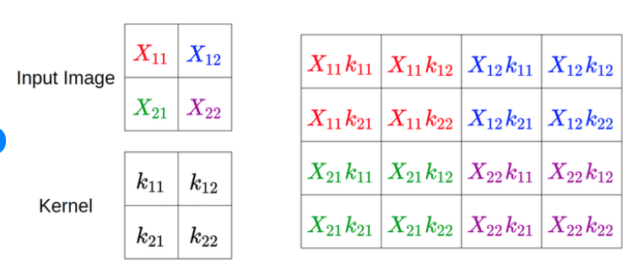

Slide 10
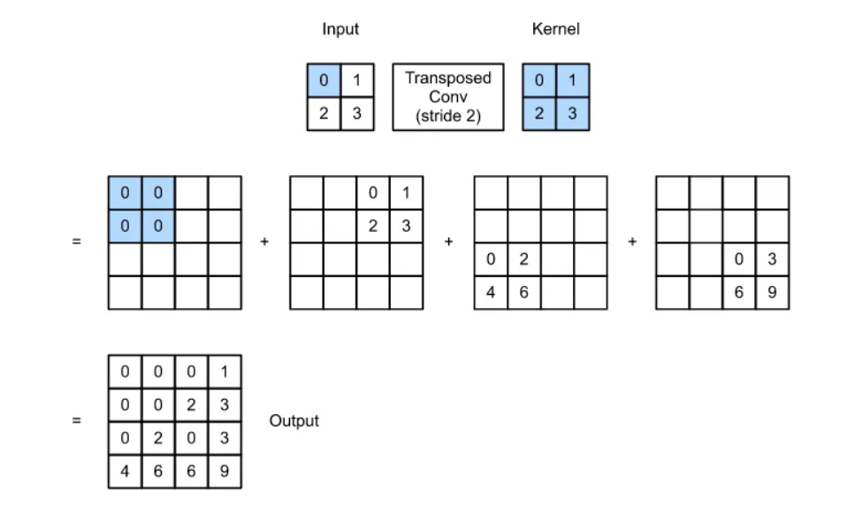

Slide 11
First Expansive Convolutional Set: Apply two sets of 3x3 convolutions with 512 filters, maintaining the size at 56x56.
Second Up-convolution: Increase size to 104x104 while halving the feature channels to 256.
Second Concatenation: Concatenate with the corresponding cropped feature map from the contracting path (from step 7).
Final Layer
Output Convolution: Apply a 1x1 convolution to map each 64-component feature vector to the desired number of classes.
Second Expansive Convolutional Set: Apply two sets of 3x3 convolutions with 256 filters, maintaining the size at 104x104.
Third Up-convolution: Increase size to 200x200 while halving the feature channels to 128.
Third Concatenation: Concatenate with the corresponding cropped feature map from the contracting path (from step 5).
Third Expansive Convolutional Set: Apply two sets of 3x3 convolutions with 128 filters, maintaining the size at 200x200.
Fourth Up-convolution: Increase size to 392x392 while halving the feature channels to 64.
Fourth Concatenation: Concatenate with the corresponding cropped feature map from the contracting path (from step 3).
Fourth Expansive Convolutional Set: Apply two sets of 3x3 convolutions with 64 filters, maintaining the size at 392x392.

Slide 12
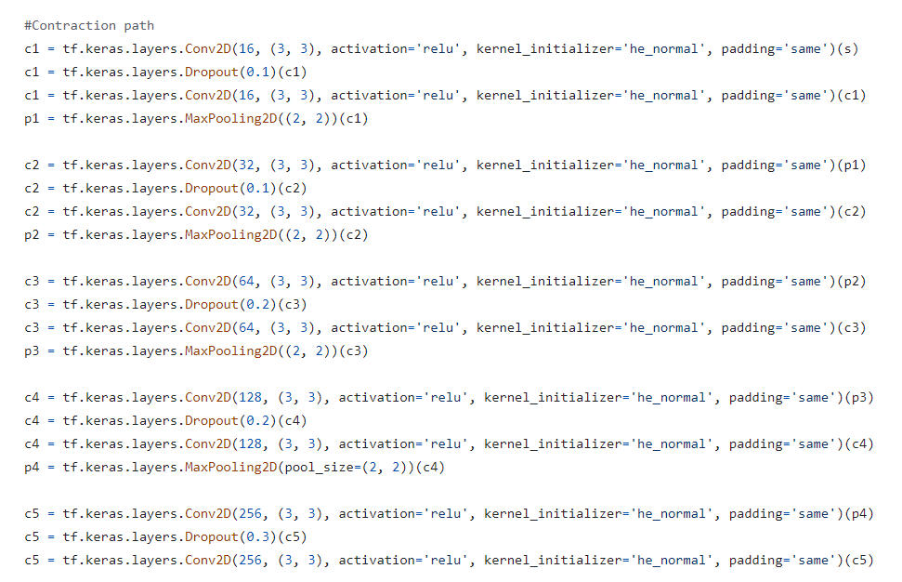

Slide 13
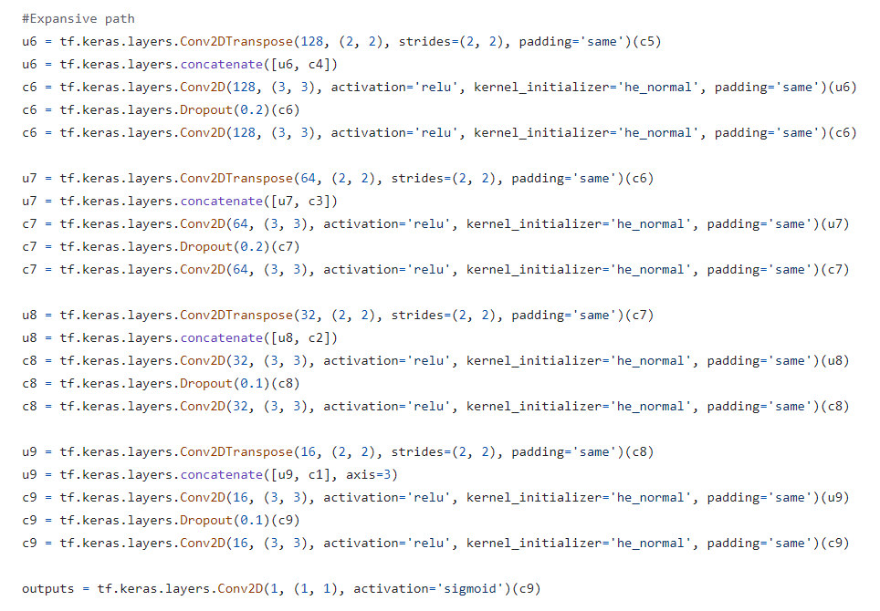

Slide 14
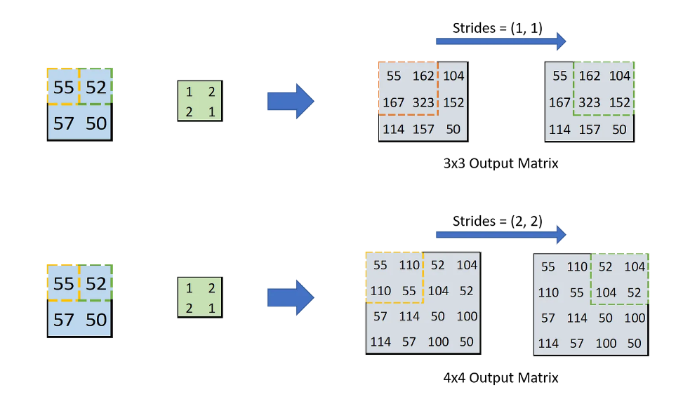

Slide 15
